Slide 1


CONTROL UNIT
Associates
Onkar Chavan
Hema Chandran P
Sayli Atkare
Pushpa S Malebennuru
Nandesh O N

Slide 2

contents
Introduction
HISTORY
OBJECTIVE
REQUIREMENTS
TEST CASES
SYSTEM BLOCK DIAGRAM
HARDWARE BLOCK DIAGRAM
FUNCTIONAL BLOCK DIAGRAM
SEQUENTIAL BLOCK DIAGRAM
SCOPE
CONCLUSION

Slide 3


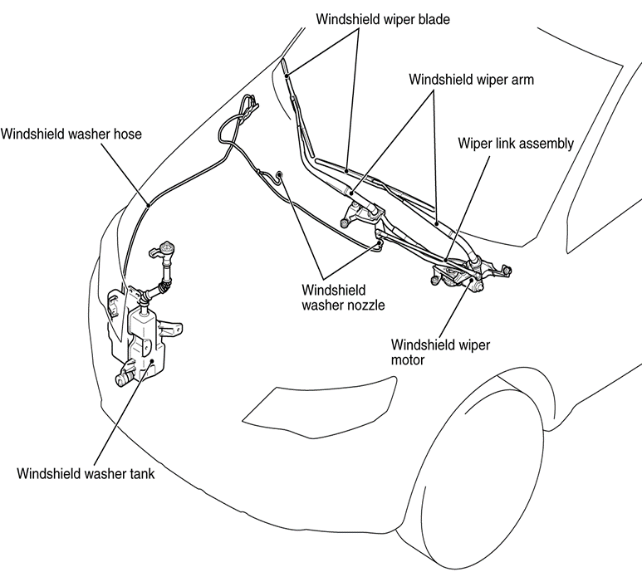
A wiper and washer is used to remove rain, snow, ice, washer fluid, water from a vehicle's front and rear window , almost all motor vehicle including cars, trucks, buses, train locomotives.
Wiper and Washer are usually a legal requirement.
a wiper generally consists of a metal arm one end pivots, the other end has a long rubber blade attached to it. the arm is powered by a motor.
The blade is swung back and forth over the glass, pushing water, other precipitation, or any other impediments to visibility, from its surface.

Slide 4
HISTORY
At least three inventors patented windscreen cleaning devices at around the same time in 1903 Mary Anderson, Robert Douglass, and AP john.
American inventor mary anderson is popularly credited with devising the first operational windshield wiper in 1903.
In Anderson's patent, she called her invention a "window cleaning device" for electric cars and other vehicles

Slide 5
OBJECTIVE
In this project we need to,
Control front and rear wiper manually using switch.
Receive status of washer and wiper control, battery, washer fluid tank and rain sensor input in CAN receiver after the transmission through switch.
Transmit hardware warning lamp status to washer output control.

Slide 6
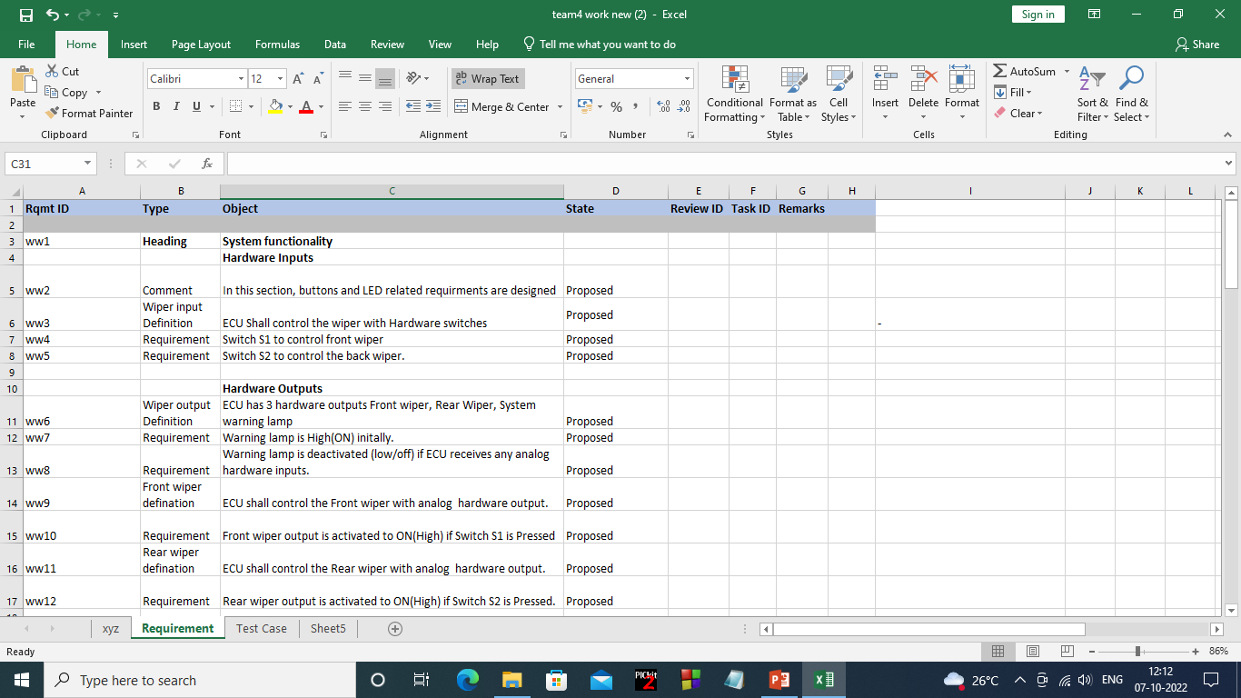
REQUIREMENTS

Slide 7
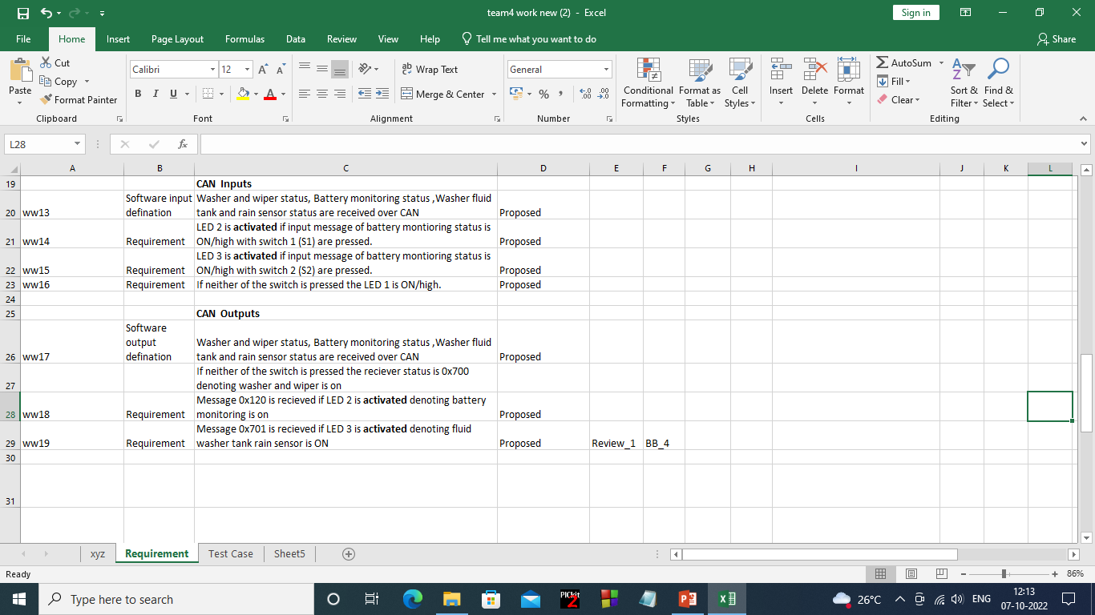

Slide 8
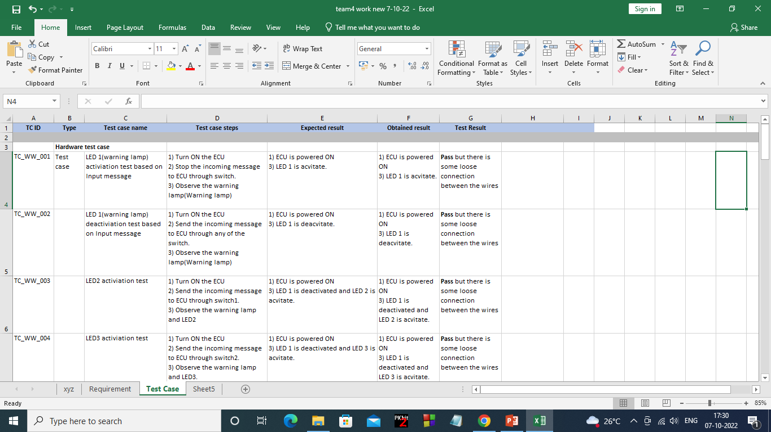
TEST CASES

Slide 9
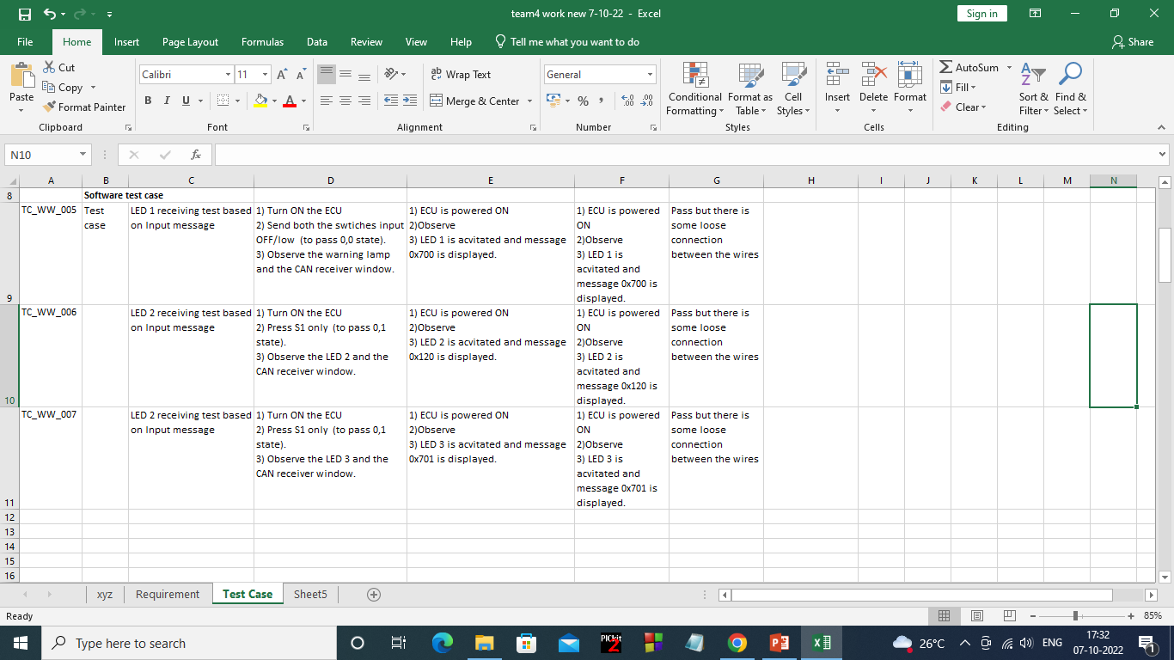

Slide 10
System Block Diagram
Battery monitoring
Washer fluid tank
Rain sensor
CAN I/P
Wiper inputs
(Switches)
S1
Wiper and Washer
ECU
L1
Warning Lamp
S2
L2
Front Wiper
Power supply
Rear Wiper
L3
CAN O/P
H/W Inputs
Battery warning lamp status
Washer output control
Rain sensor and fluid washer tank
CAN input
H/W output
CAN output
ECU

Slide 11

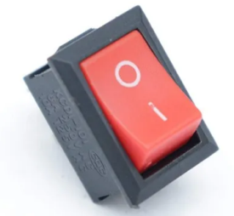

Hardware Block Diagram
Microcontroller
PIC18F458
LED 1
Switch 1
Warning lamp
LED 2
FRONT WIPER
Switch 2
LED 3
REAR WIPER
Power supply
ECU
INPUT
OUTPUT

Slide 12

Functional Block Diagram
1
can_init ()
TRISbits.RB2(To DISABLE can transmitter) &
TRISbits.RB3 (to ENABLE receiver)
PIE3,IPR3To enable receive buffer interrupt &
CANSTAT( to set baud rate)
system_init ( )
GIE(to enable global)
PEIE(to enable interrupt)
2
8
warning_lamp ( )
LATDbits.LD2 to on/off warning lamp
LATDbits.LD1 to on/off rear wiper
LATDbits.LD0 to on/off front wiper
led2 ( ) & led3 ( ) to ON front & rear wiper respectively
Main Function
system_init ( )
can_init ()
transmit ( )
receive ( )
set_baudrate ( )
mask_set ( ) & filter_set ( )
led2 ( ) & led3 ( )
warning_lamp ( )
7
3
transmit ( )
CANCON(to set normal mode)
TXB1SID(H/L)-to intialize transmission buffer HIGH and LOW.
TXB1DLC(to intialize date length)
TXB1CON(to set transmission buffer config. to normal mode)
6
mask_set ( ) & filter_set ( )
RXM0SID(H/L)-enable acceptance mask as high and low.
RXF0SID(H/L)-enable acceptance filter as high and low.
receive ( )
CANCON(to set normal mode)
RXB1SID(H/L)-to intialize transmission buffer HIGH and LOW.
RXB1DLC(to intialize date length)
RXB1CON(to set transmission buffer config. to normal mode)
4
set_baudrate ( )
CANCON(to set normal mode)
BRGCON1(to calculate baudrate)
CIOCAN(CAN i/o config.)
5

Slide 13
System initialization
Start
System_init()
Interrupt
(Global Enable)
GIE=ENABLE
Interrupt (Pheripheral Enable) PEIE=ENABLE
End

Slide 14
CAN Initialization
Start
Enable receiver
Disable transmitter
CANCON –Normal mode
Configuration
CAN status!= 80
yes
no
Set Braud rate
Stop

Slide 15
led2( )
Start
TRISCbits.RC0=1
TRISDbits.RD0=0
PORTCbits.RC0==0
PORTCbits.RC0==1
Switch 1
no
yes
yes
LATDbits.LD0=1
LATDbits.LD0=0
led
led
STOP

Slide 16
led3( )
Start
TRISCbits.RC1=1
TRISDbits.RD1=0
Switch 2
PORTCbits.RC1==1
PORTCbits.RC1==0
no
yes
yes
LATDbits.LD1=1
LATDbits.LD1=0
led
led
STOP

Slide 17
Warning lamp( )
Start
TRISDbits.RD2=0
LATDDbits.LD2=1
Switch 2
PORTCbits.RC1==0
OR
PORTCbits.RC1==0
no
LATDbits.LD2=1
yes
led
LATDbits.LD2=0
STOP
led

Slide 18
SCOPE
The scope of this study is to implement a design to incorporate into the wiper unit to operate manually.
Additional cost is required incase optical sensor is used. this system applied in the case of moisture falling on the sensor only, and its only active when the ignition is powered.

Slide 19
CONCLUSION
As the conclusion for the project, the results shows all the aim objectives are successfully achieved. The wiper system was well functionally working according the switch condition for the windscreen of the car. The status of the inputs were obtained through CAN. This project showed a contribution on the design of the automatic wiper system for the future research in this field.

Slide 20
THANK-YOU

